Slide 1

Virtualization &
Cloud Computing

Slide 2

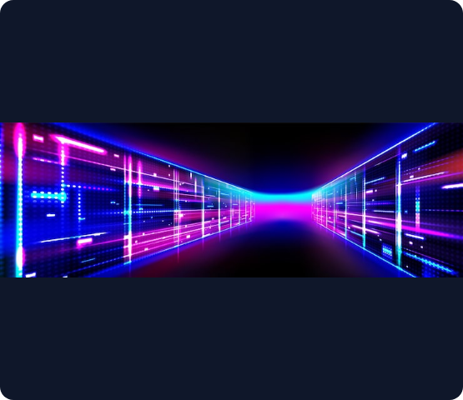

What is Virtualization?
Virtualization is the technology of creating a virtual version of a physical computing resource. It allows multiple virtual systems to run simultaneously on a single physical computer, with each behaving like an independent machine.
Key Applications:
Operating Systems & Servers
Storage Arrays
Networks & Infrastructure
Software Applications

Slide 3


Virtual Machines & Client-Side
CLIENT-SIDE VIRTUALIZATION
VIRTUAL MACHINES (VMS)
The Host / Guest Model
Software-Based Computers
Runs virtual machines directly on a user's local, personal computer.
A VM uses virtualized resources to operate completely isolated from other VMs on the same hardware.
•
The Host: The physical computer providing the underlying hardware.
Core Components of a VM:
•
Virtual CPU (vCPU) & Virtual RAM
•
The Guest: The virtual computer running on top of the host.
•
Virtual Hard Disk (VHD/VMDK)
•
Virtual Network Adapter
Each guest maintains its own isolated OS, applications, files, and virtualized hardware without altering the host OS.
•
Guest Operating System

Slide 4








Virtual Machine Architecture
How hardware resources are abstracted and shared to create independent environments.
1. Physical Hardware
2. Host OS (Optional)
3. Hypervisor
4. Virtual Machines
The software layer that creates, manages, and allocates resources to the virtual machines.
The base server or computer providing the actual CPU, RAM, and storage resources.
The primary operating system running on the physical hardware (required for Type 2 hypervisors).
Isolated guest environments (e.g., Windows VM, Linux VM) running their own apps.

Slide 5
Hypervisor Types
TYPE 1
TYPE 2
Bare Metal Hypervisors
Hosted Hypervisors
Runs directly on the physical hardware without an underlying host operating system.
Runs as a software application on top of an existing host operating system.
•
Highly efficient and secure.
•
Easy to install and configure.
•
Direct access to hardware resources.
•
Relies on the host OS for hardware access.
•
Commonly used in enterprise data centers.
•
Commonly used on personal computers.
Examples: VMware ESXi, Microsoft Hyper-V, Proxmox VE.
Examples: Oracle VirtualBox, VMware Workstation.

Slide 6
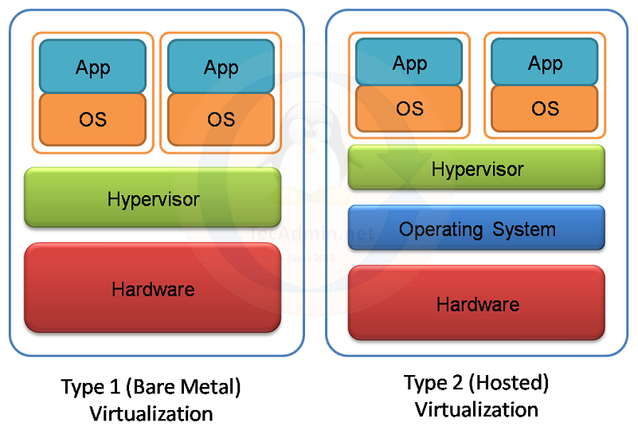

Slide 7








Benefits of Virtualization
Flexibility & Scalability
Cost Reduction
Easily scale up or down by provisioning more virtual machines or resources as needed, without physical limitations. Run multiple operating systems, applications, or environments on the same physical infrastructure,
Reduces hardware purchases, power consumption, and cooling by consolidating systems.
Security & Isolation
Backup & Recovery
Security issues or crashes in one VM do not affect the host or other running VMs.
VM snapshots and image files simplify point-in-time recovery and migration.

Slide 8
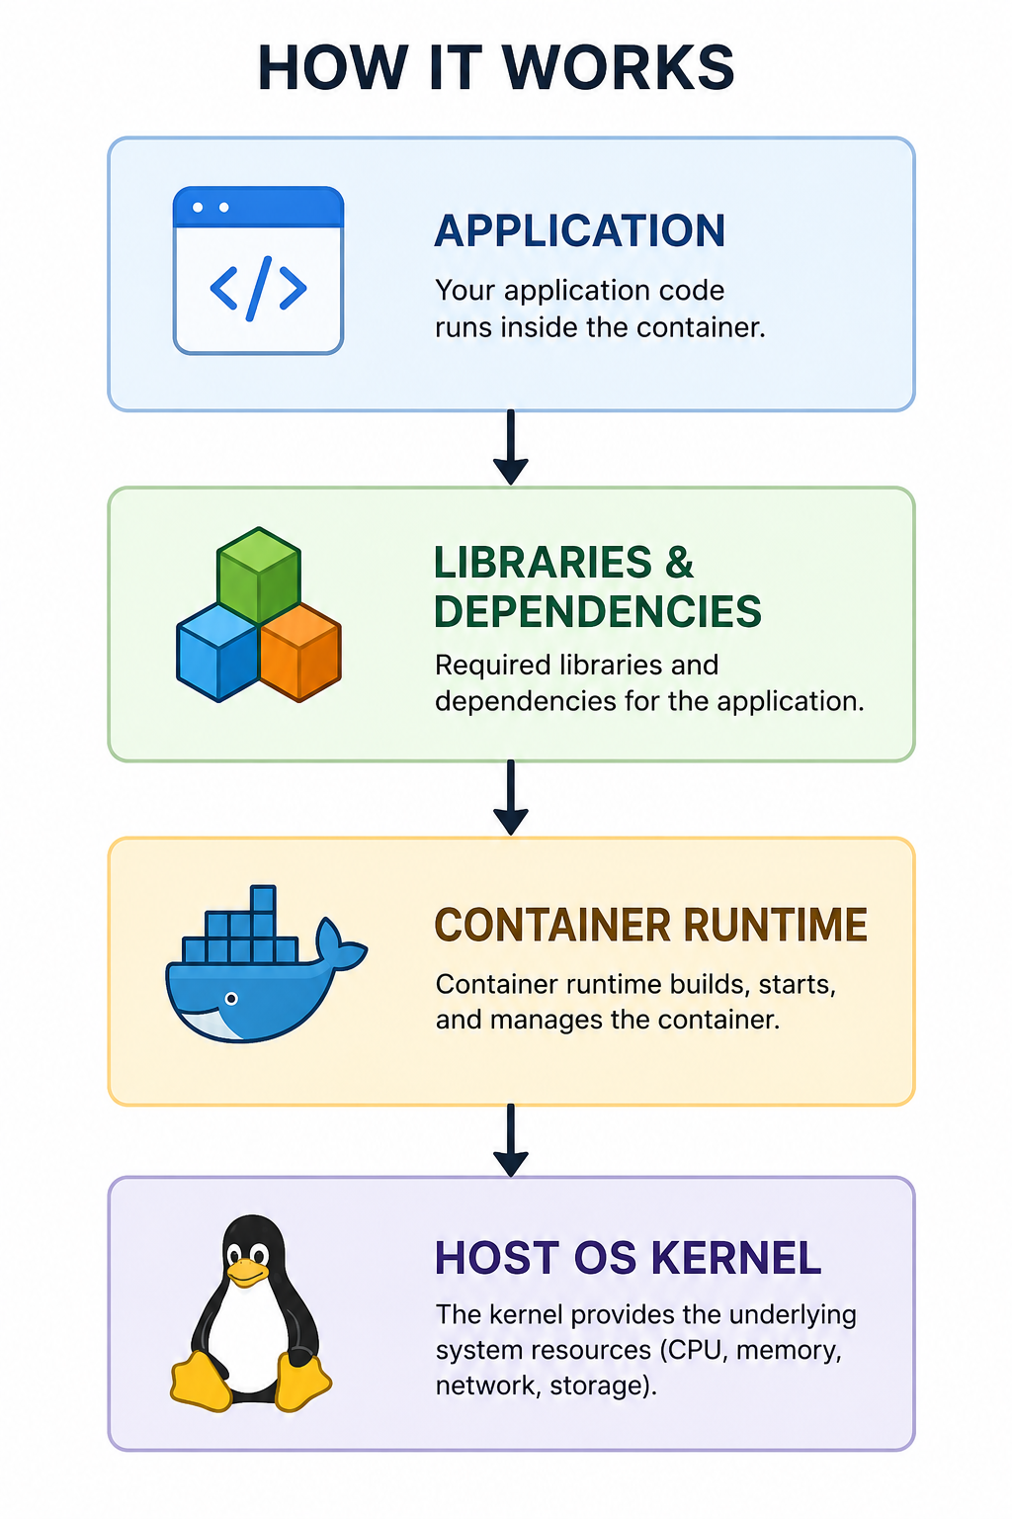
CONTAINERS
WHAT IS A CONTAINER?
  A container is a lightweight, isolated environment that packages an application with its code, libraries, and dependencies.
  Lightweight, Portable, and Fast Application Deployment
  Containers share the host OS kernel, making them faster and more resource-efficient..

Slide 9
Feature | Virtual Machine (VM) | Container
Isolation | Full OS + dedicated kernel | Isolated processes, shared host kernel
Resource Usage | 🟥 Higher | 🟩 Lightweight
Startup Time | 🟥 Seconds–Minutes | 🟩 Milliseconds
Best For | Multiple OS types, legacy apps, testing | Microservices, rapid deployment, scaling

Slide 10
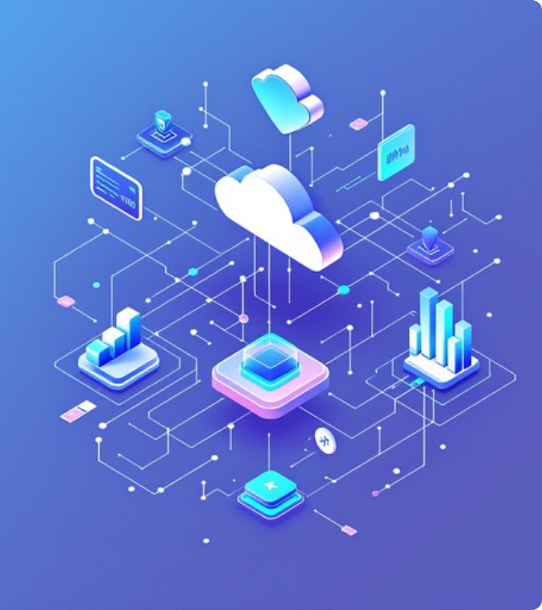
THE NEXT STEP
What is Cloud Computing?
Cloud computing is the delivery of computing resources over a network—usually the Internet—on demand.
Key Characteristics:
On-demand self-service access
Broad network accessibility
Resource pooling and sharing
Rapid elasticity and scalability
Pay-as-you-go pricing model

Slide 11



Cloud Service Models
IAAS
PAAS
SAAS
Infrastructure
Platform
Software
Provides virtualized computing infrastructure (VMs, storage, networks). You rent the hardware.
Provides a ready-to-use environment with runtime, databases, and tools. You rent the dev environment.
Provides complete, ready-to-use software applications over the internet. You rent the app.

Slide 12

IaaS vs PaaS vs SaaS
Feature | IaaS | PaaS | SaaS
Provides | Base Infrastructure | Development Platform | Complete Application
User Control Level | High (OS, Data, Apps) | Medium (Code, Data) | Low (User Config Only)
Primary Users | IT Admins & SysOps | Software Developers | End Users
Analogy | Renting a blank computer | Renting a dev workstation | Using a finished app

Slide 13






Cloud Deployment Models
Public Cloud
Private Cloud
Hybrid Cloud
Infrastructure is owned by a provider and shared across multiple customers over the public internet.
Infrastructure is dedicated exclusively to a single organization for maximum control and security.
Combines private and public clouds, allowing data and apps to be shared between them seamlessly.

Slide 14
Edge Computing
Edge computing processes data closer to its source.
It reduces latency and bandwidth usage.
It integrates with cloud computing and virtualization.
Enables real-time data processing at or near the data source.
Essential for IoT, autonomous vehicles, and other latency-sensitive applications.
Uses virtualized and containerized environments on edge devices.
Edge devices often connect to a central cloud for additional processing and storage.

